Slide 1
Ministry of Education Website 18110004

Slide 2
Introduction:
I work for as front-end developer for a leading web-solutions and marketing company, where I have been tasked by my manager to create an interactive modern website for one of the governmental partners departments in Jordan (Ministry of Education, Ministry of Higher Education, Ministry of Health, Ministry of Water and Irrigation, Ministry of Foreign Affairs). For this task, I’ve chosen to create the website for the Ministry of Education; because after looking thoroughly at their existing website, I’ve found that it needs an upgrade, because it is not as modern as the other country’s Ministry of Educations and doesn’t have functionalities that help the parents and students.

Slide 3
Website Design and Development - Research
DNS (Domain Name Server)
Purpose of DNS
Types of DNS
How the domain names are organized and Managed
Purpose and relationships between communication protocols, server hardware, operating systems and web server software with regards to designing, publishing and accessing a
Website
Definition
Purpose for Publishing Website
Relationship

Slide 4
Website Design and Development - Research
Web Development Technologies and Framework
Influence of search engines on website performance

Slide 5
Website Design and Development – Implementation
Analysis of the Website
Home Page
Students
Parents
Schools system
About Us and Contact Us
Website Creation Tools and Methods
Method Used/ UX and UI Evaluation
Technologies
Front-End Technologies
Back-End Technologies
Capabilities of Backend and Frontend Technologies
Relationship between Frontend and Backend website Technologies
How frontend and backend relate to presentation and application layer
Tools and Techniques involved in building a custom website

Slide 6
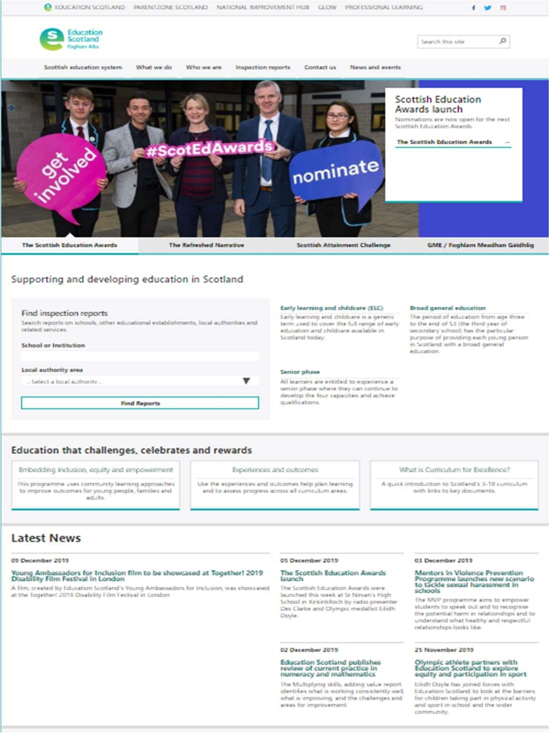
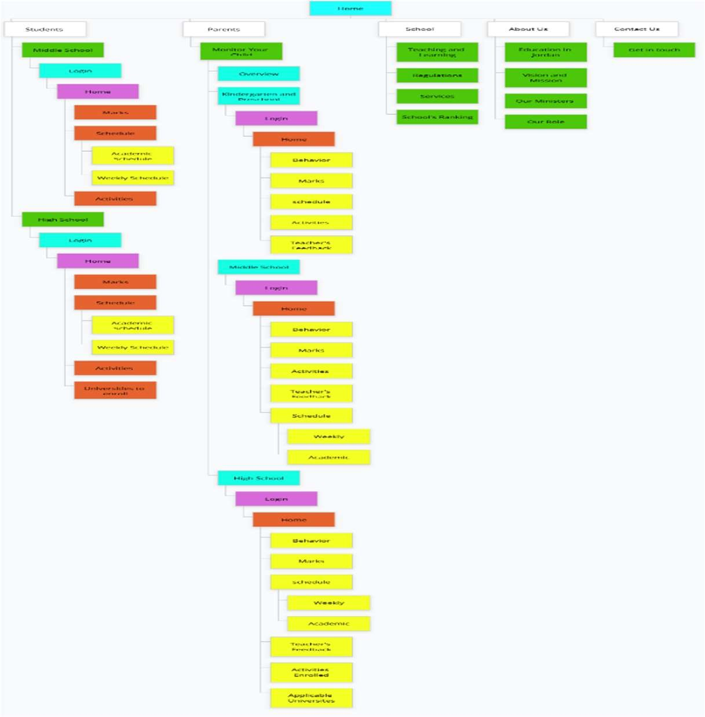
Website Design and Development – Implementation
Shortlisting
Site Map

Slide 7
Wireframes

Slide 8
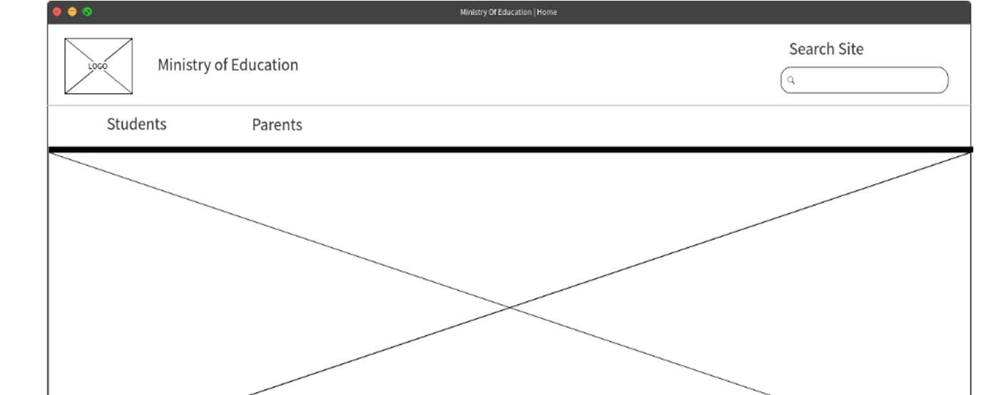
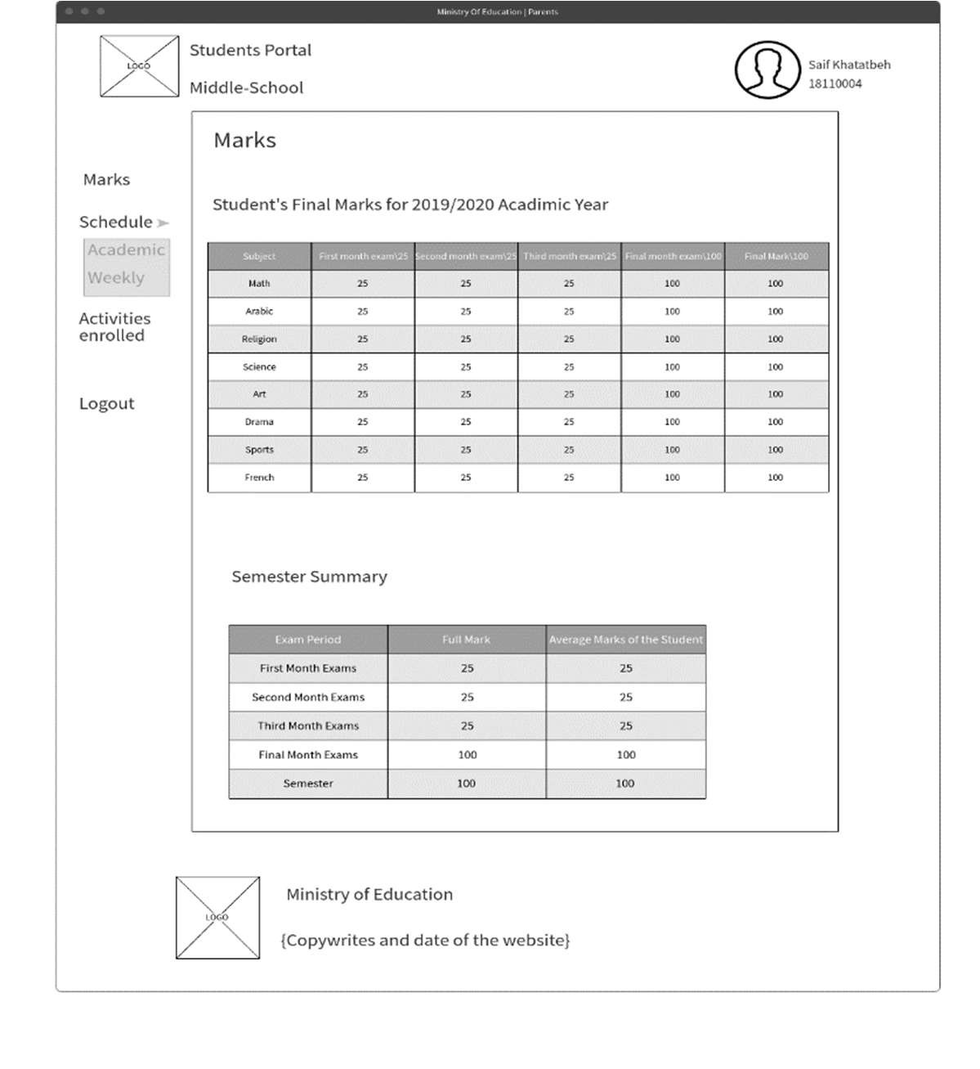
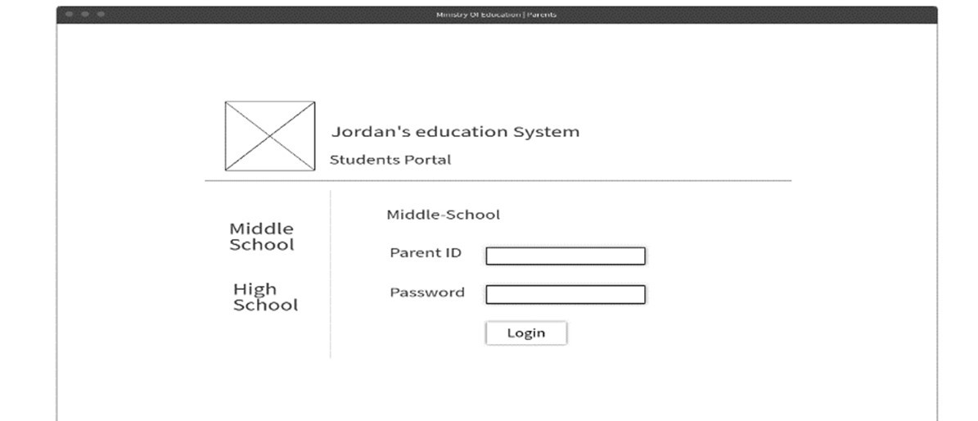
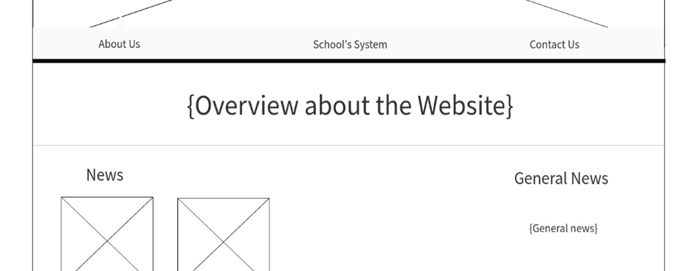
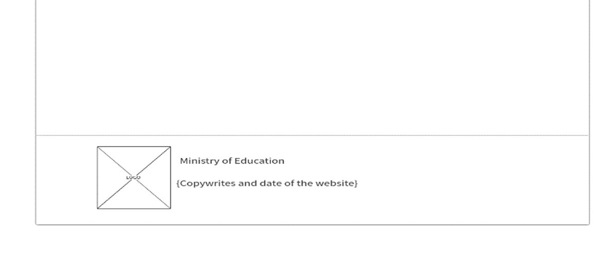
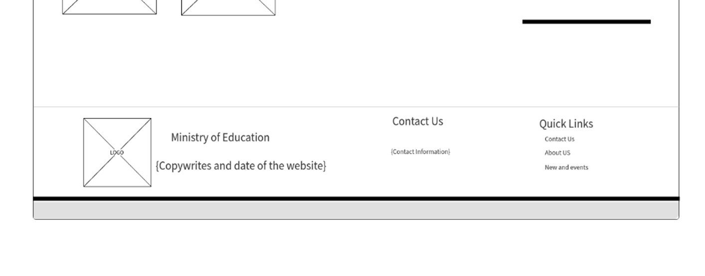
Students
Middle school
Home page
Marks
Login

Slide 9
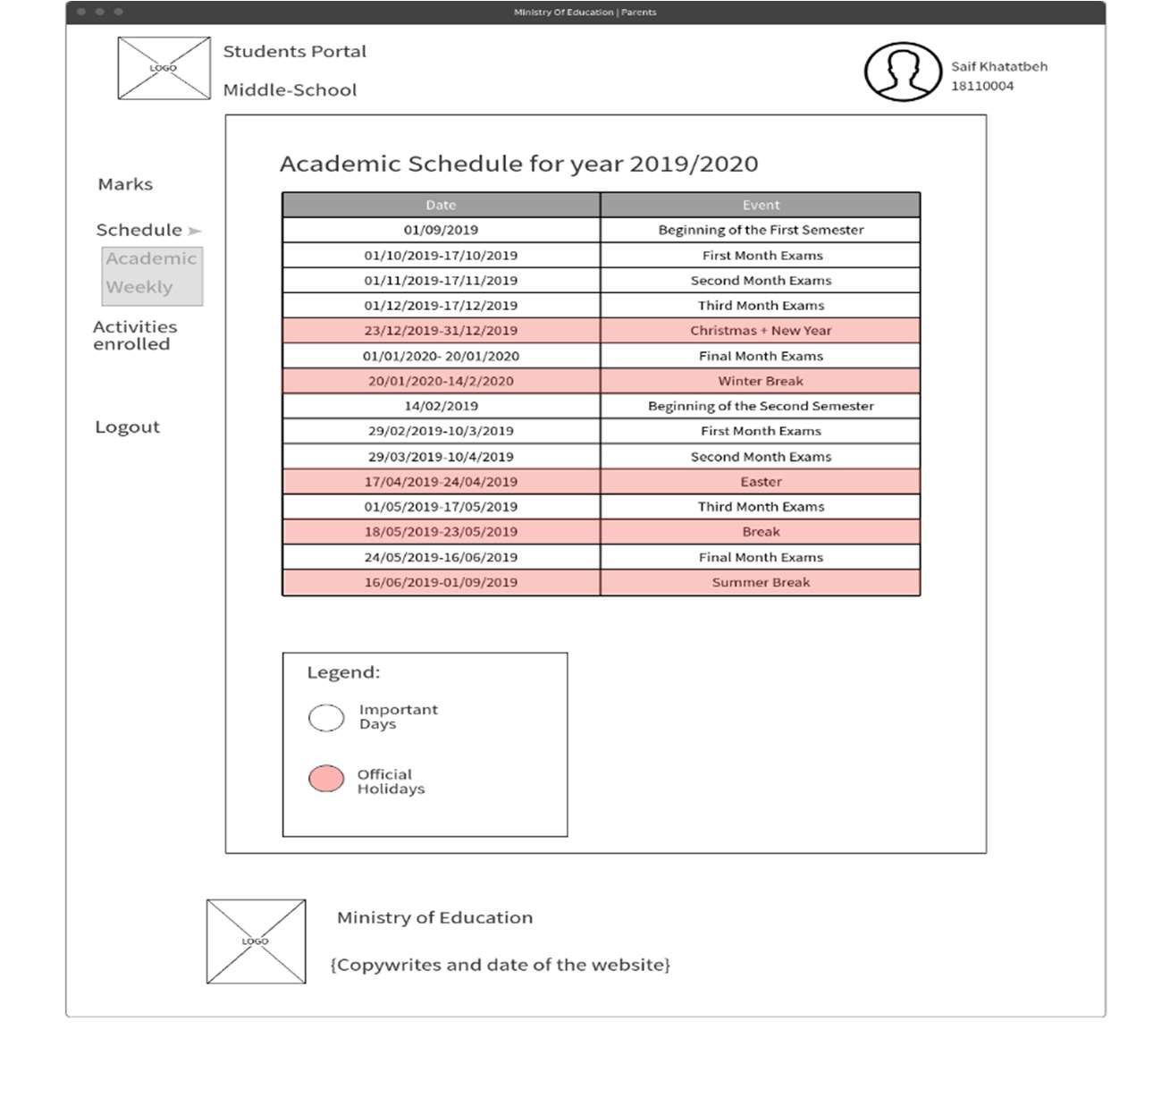
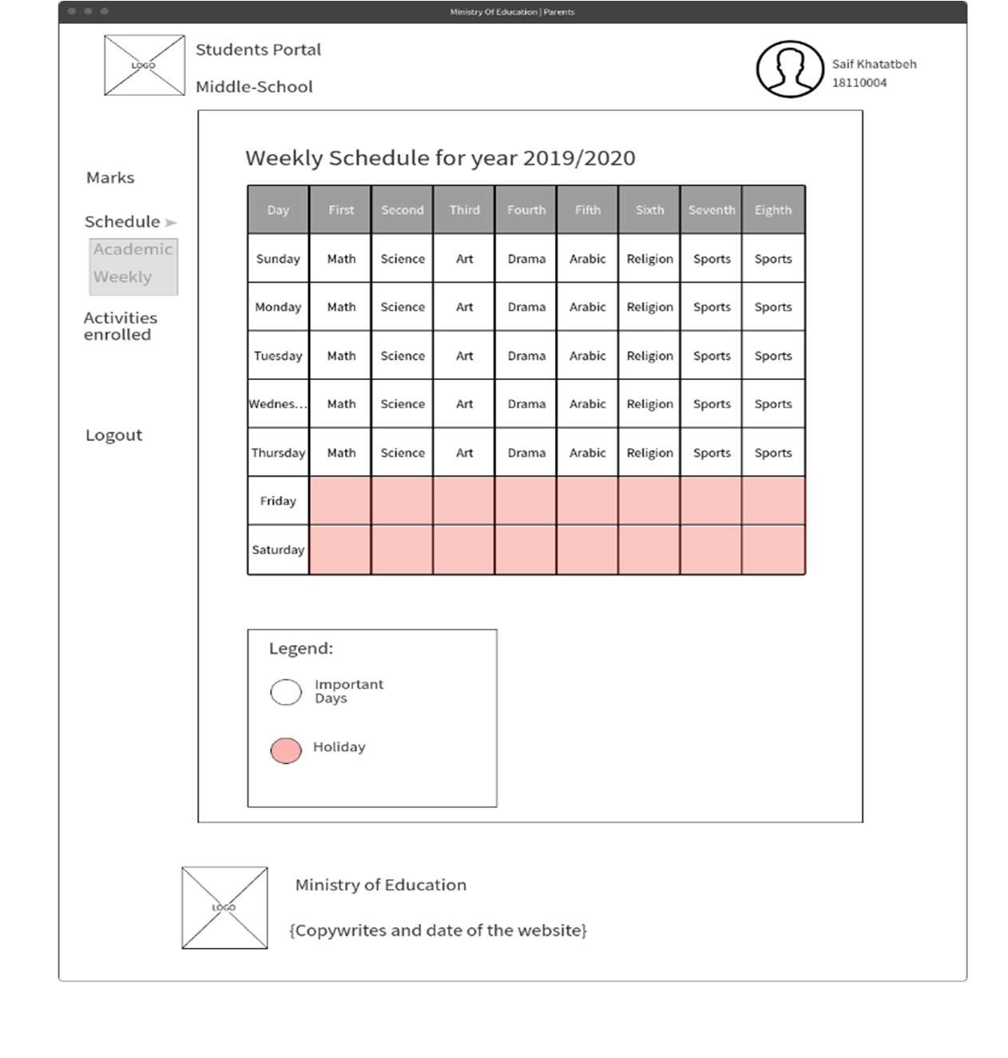
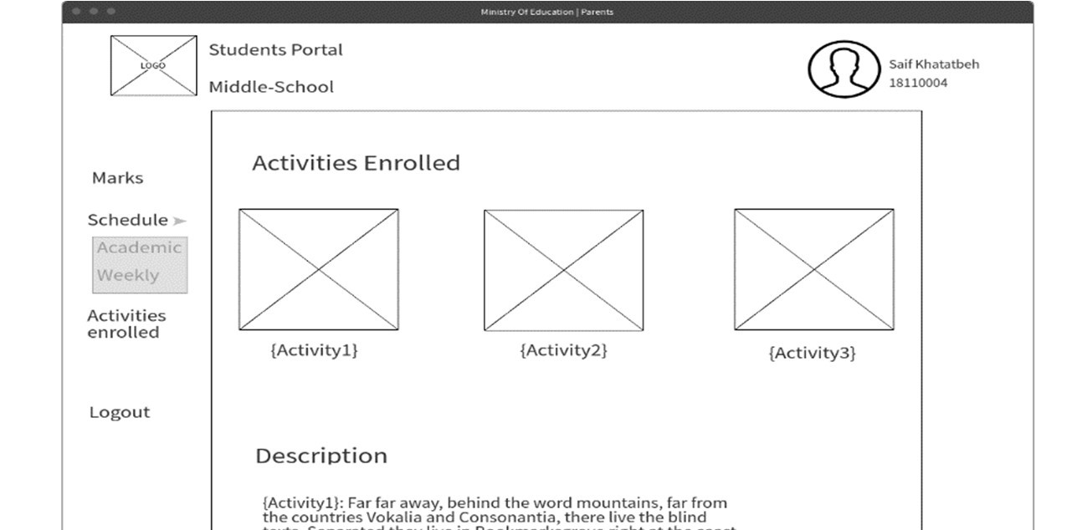
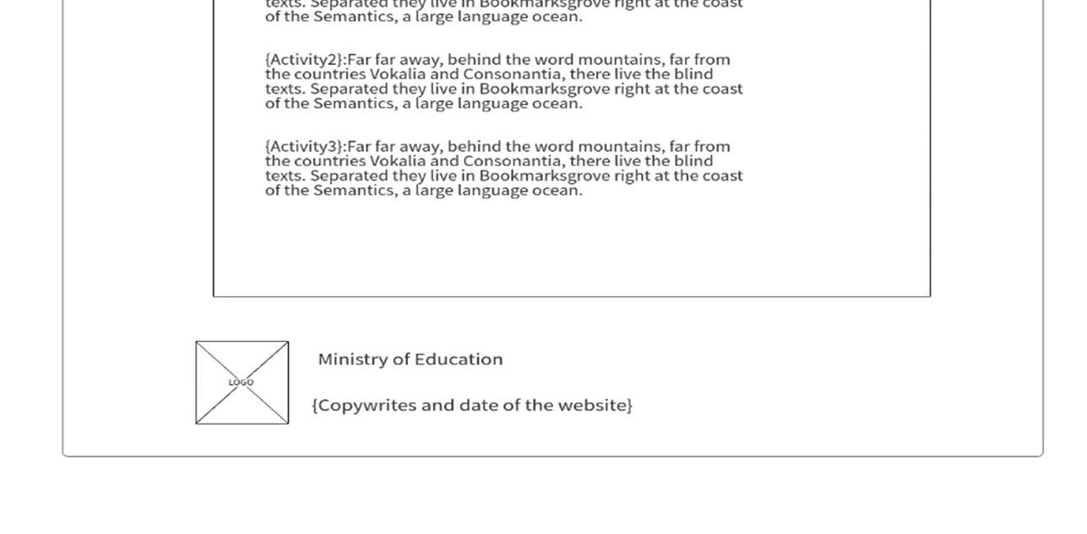
Students
Middle school
Schedule (Academic)
Schedule (Weekly)
Activities Enrolled

Slide 10
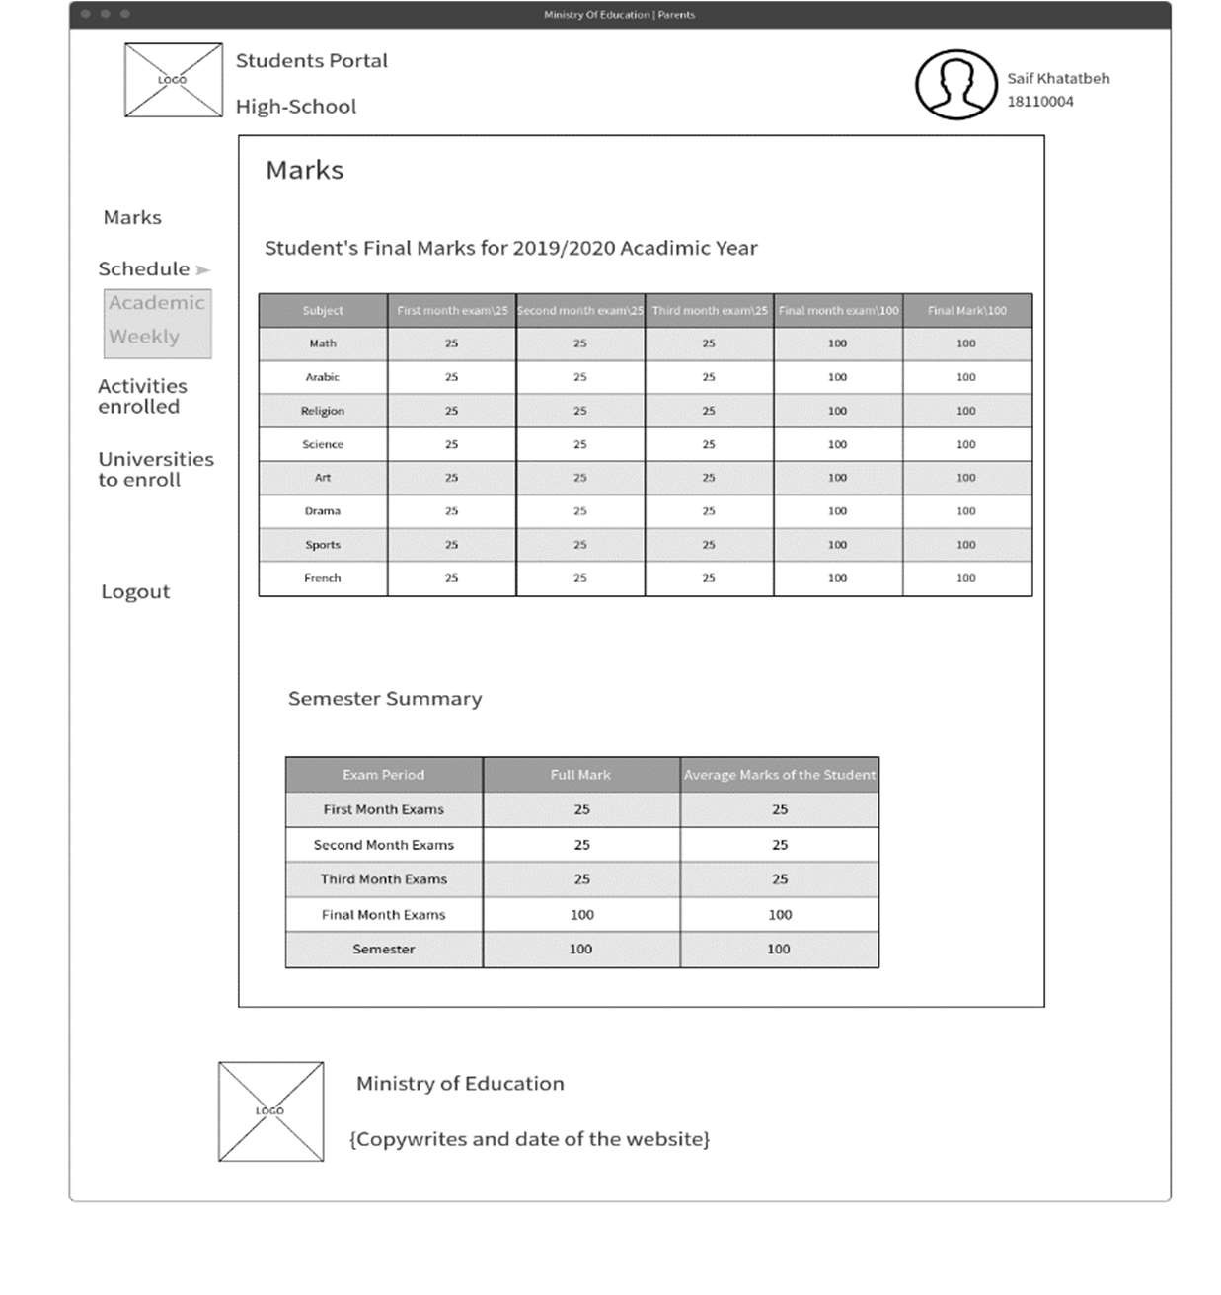
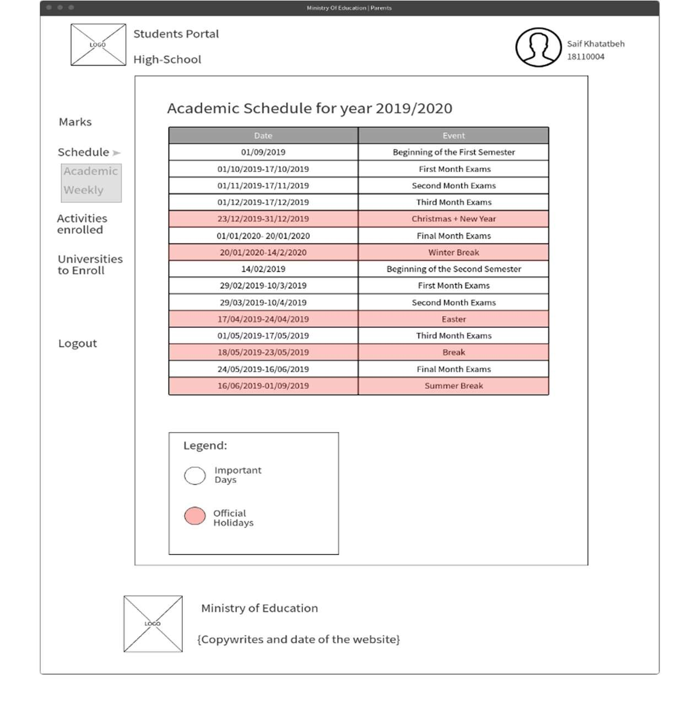
Students
High school
Marks: Schedule (Academic)
Schedule (Weekly):

Slide 11
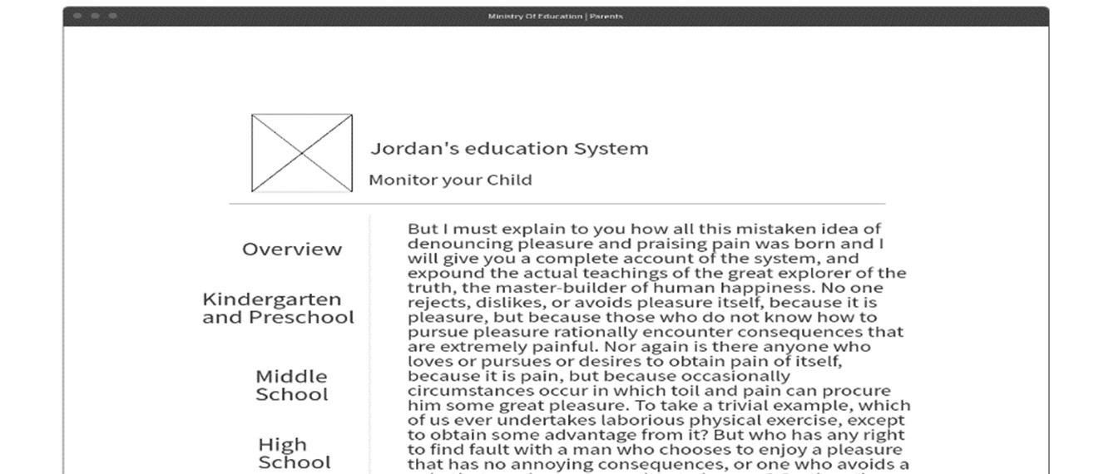
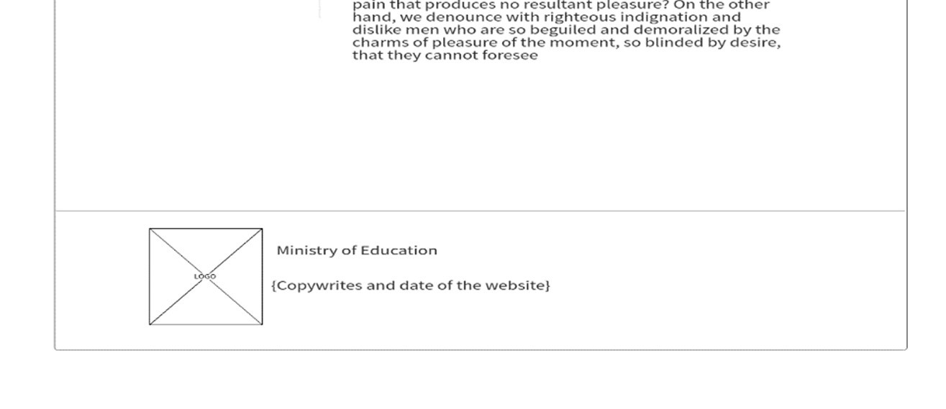
Parents
Overview

Slide 12
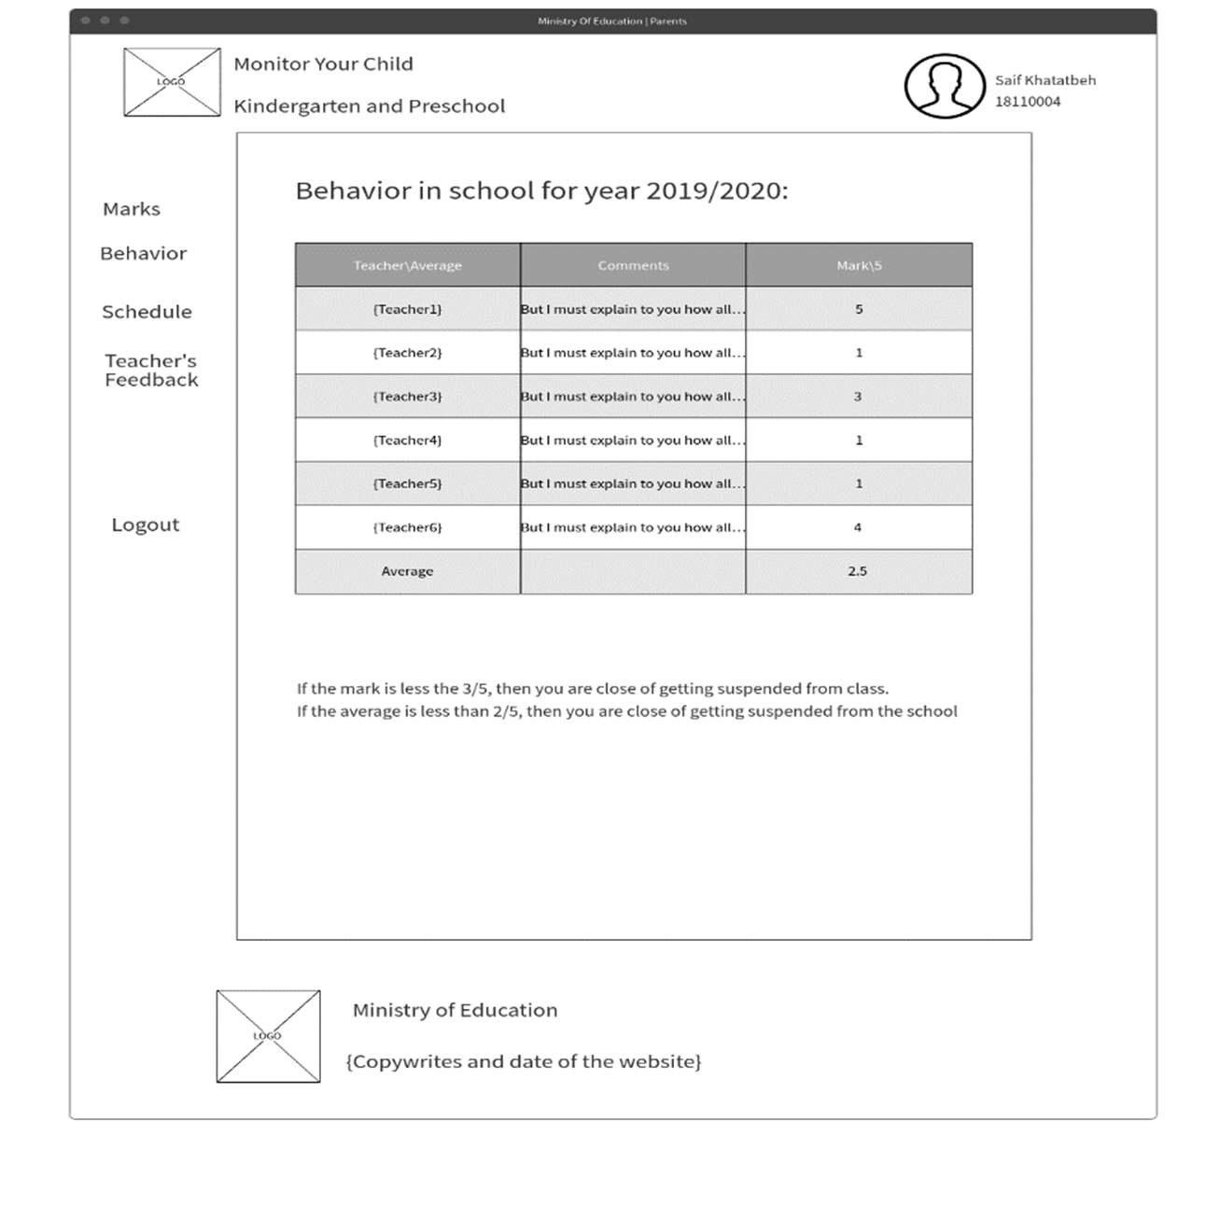
Kindergarten and Preschool
Behavior

Slide 13
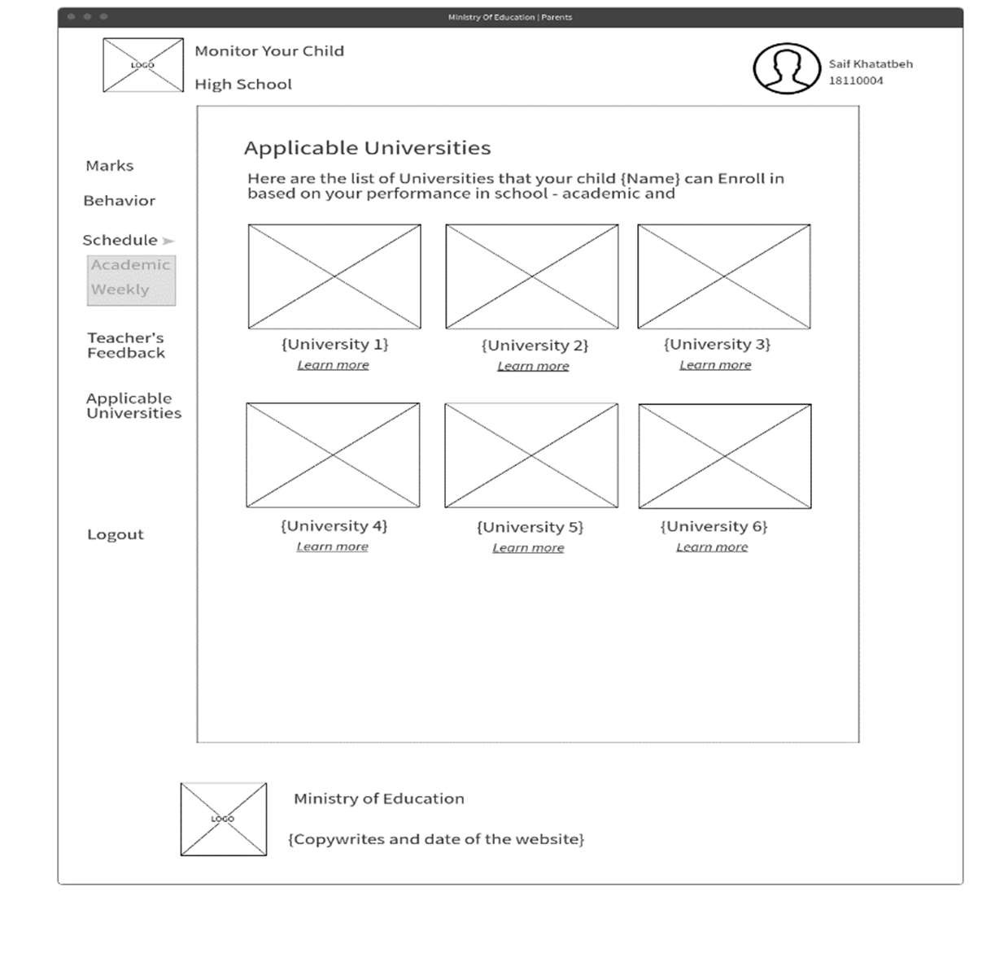
High School
Applicable Universities

Slide 14
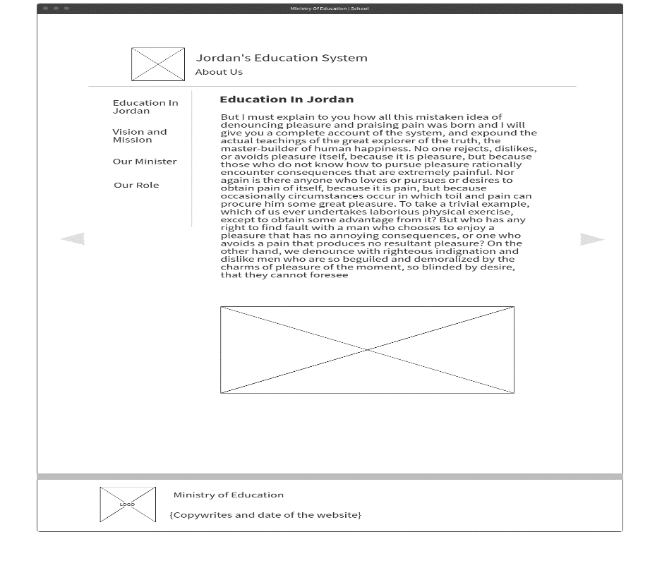
About Us

Slide 15

Vision and Mission

Slide 16
Vision and Mission

Slide 17
Mockups

Slide 18
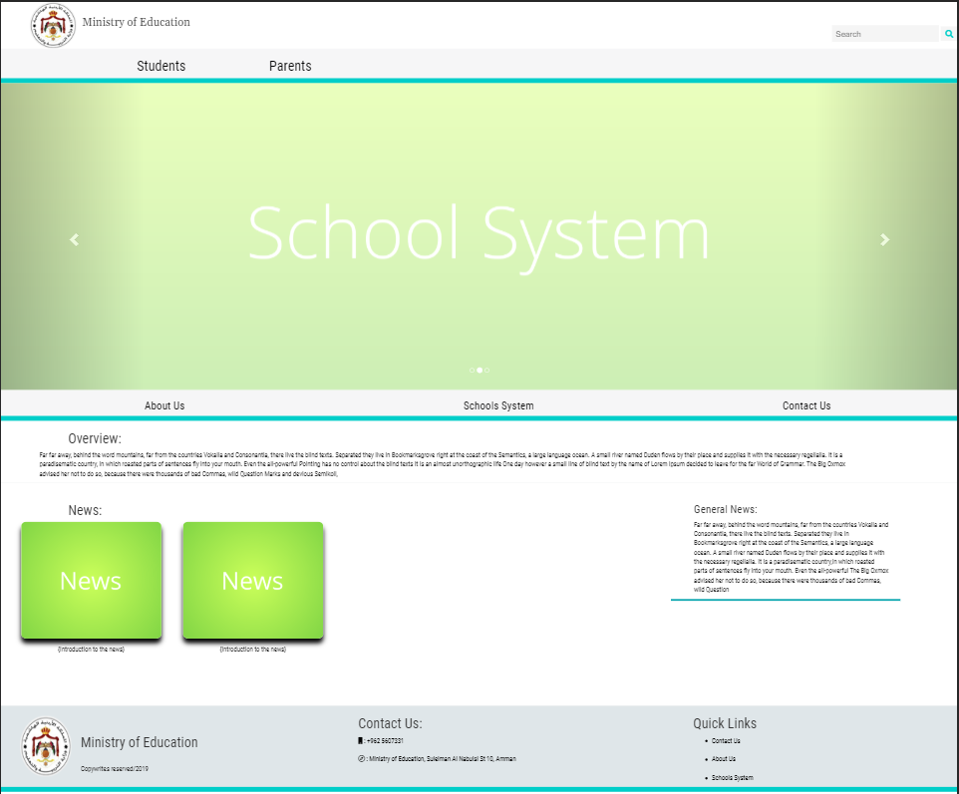
Home Page

Slide 19
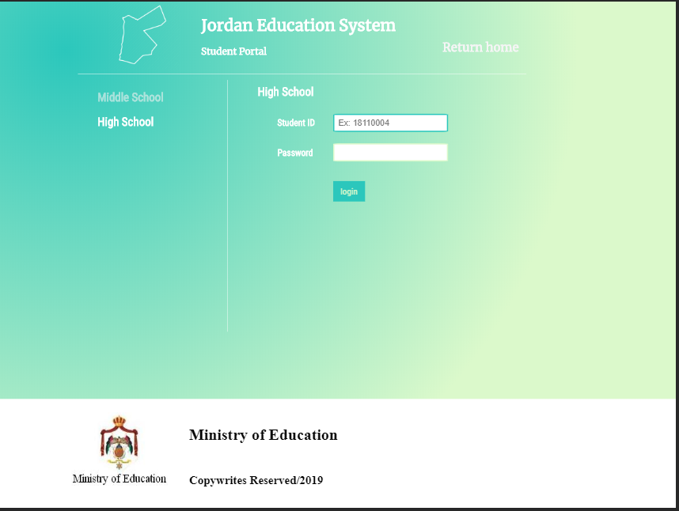
Login

Slide 20
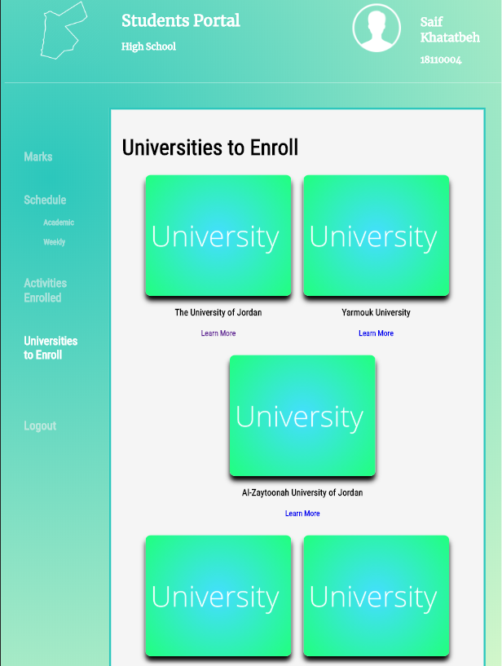
Universities to Enroll

Slide 21

Parents

Slide 22
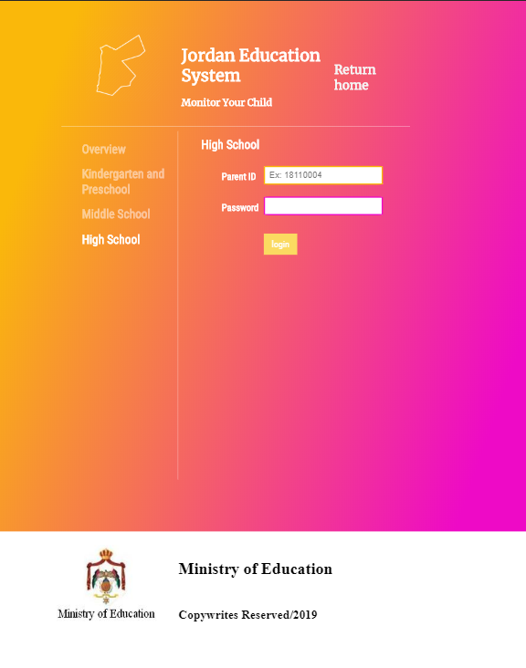
High-School

Slide 23
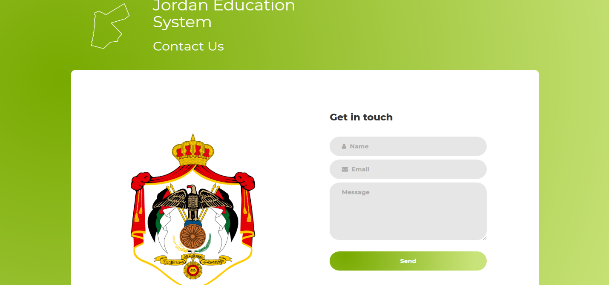
Contact Us

Slide 24
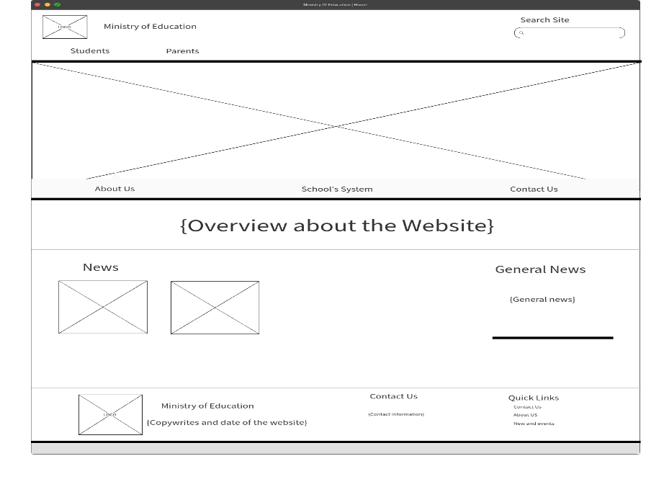

Comparison Between the Website and the DD

Slide 25
Test Plan and Quality Assurance

Slide 26
Test | Expected Result | Actual Result
Opening the Home Page | It is expected that the Home Page opens successfully with no delay and all the contents aligned as they should | Success, the Home Page opened as expected
Opening the website in a small screen (Mobile Phone) | It is expected that the website will fit itself to the screen, and interfering with the layout | Success, the website did open in a small screen with no interruptions
Entering wrong credentials on the High School portal in the students’ page | It is expected to see an error message informing the user he/she entered the wrong credentials | Success, an error message did show up.
Entering the right credentials on the High School portal in the students’ page | It is expected that the user will move to his/her dashboard. | Success, the user did move to his/her dashboard
Sending an email through the contact us page | It is expected that an email will be sent to me. | Success, an email was received
Keeping all the inputs empty on the login page then clicking send | It is expected that an error would occur | Success, an error did occur
Clicking the about us tab from the quick links in the footer | It is expected that the user will move to the About Us page | Success, the user did move to the About Us page
Clicking the return home button on the school’s system page. | It is expected that the user will return to the Home Page | Success, the user did return to the Home Page.

Slide 27
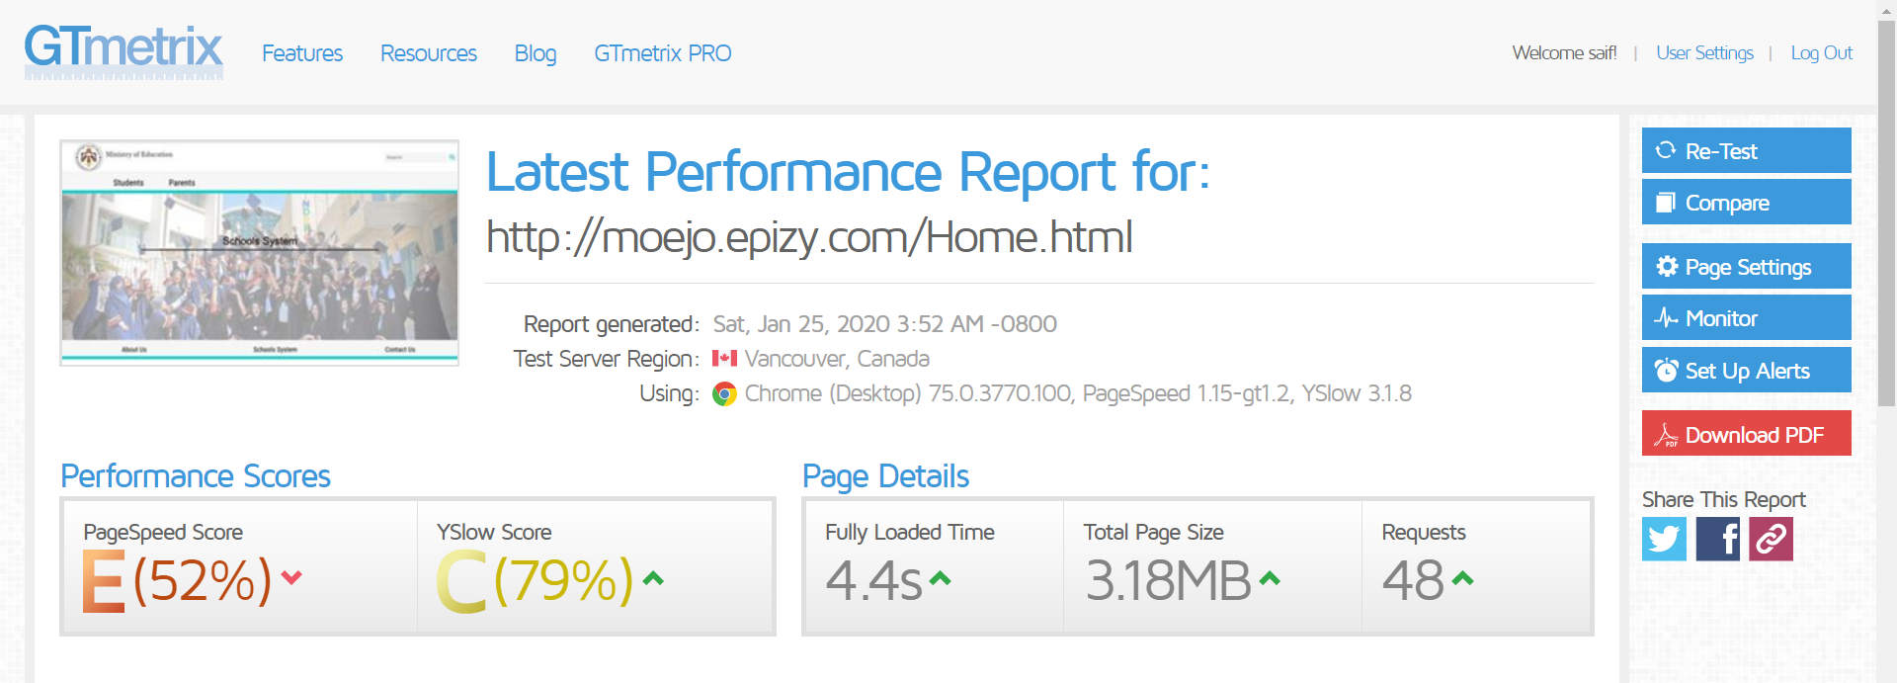
Website functionality and performance:

Slide 28
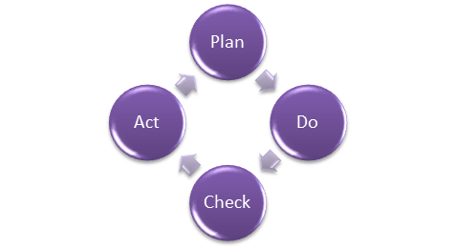
Quality Assurance

Slide 29
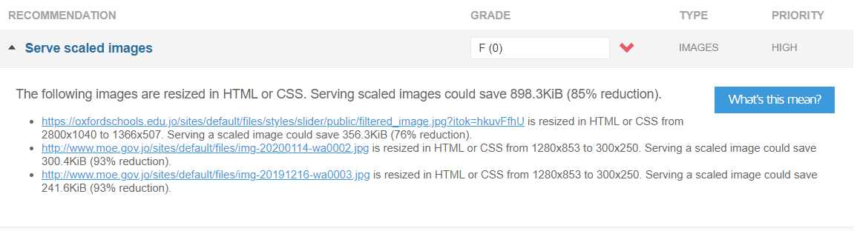
Evaluation of the Test Plan plus Potential Improvements

Slide 30
😉
Thank You,
If you have any questions, I’ll happily answer them
Now.

